Slide 1
Regression with Multilayer Perceptrons
Lecture 07

Slide 2
Overview
What is Regression
Types of regression
Linear
Bayesian
Nonlinear
Logistic
Multinomial
One vs Rest (OvR)
Multilayer Perceptron Regression

Slide 3
What is Regression
Finding a relationship between a response variable (Y) and one or more independent variables (X)

Slide 4
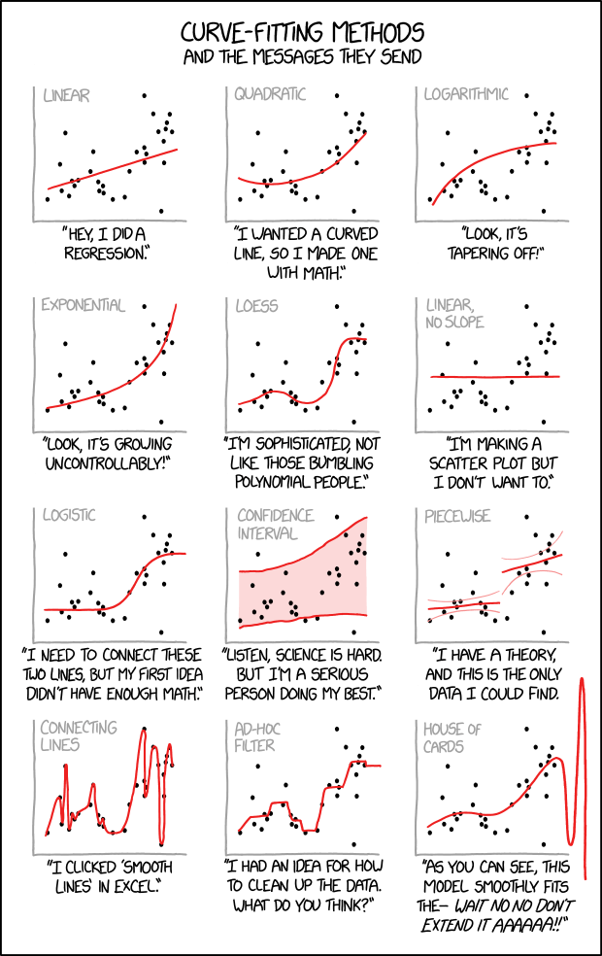

Slide 5
Types of Regression
Linear
Bayesian Linear Regression
Logistic
Poisson
Weibull
Multinomial
Probit
Ridge
Lasso
One vs Rest

Slide 6


Linear Regression
Loss function: MSE
y = mx+b+error
Assumes linear relationship between response variable and dependent variable
Linear Mapping/Model of Data
Does not necessarily mean linear line (quadratic, cubic)
Matrix calculations and Dot Product

Slide 7
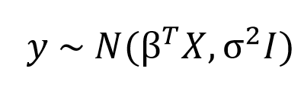
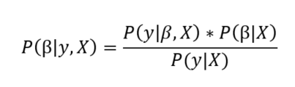
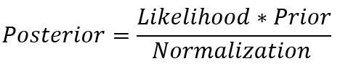
Bayesian Linear Regression
Similar to Linear regression but instead of determining a single output y, we are now interested in the posterior distribution for the model parameters
Model parameters are assumed to come from a distribution
Equation for Bayesian Linear Regression sampled from a Normal Distribution

Slide 8
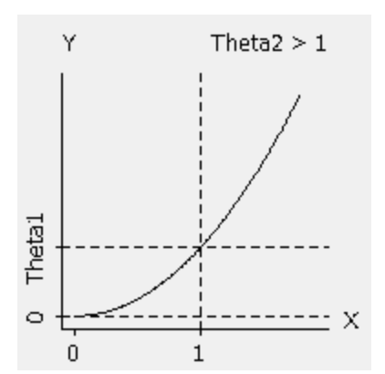
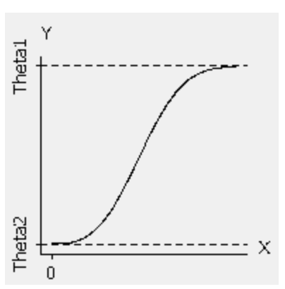
Nonlinear Regression
Does not assume linear relationship
Cannot map data linearly
Need to worry about hyperparameters and starting positions more
Non-matrix calculations

Slide 9
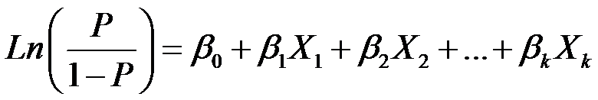
Logistic Regression
Loss Function: Log Loss (Binary Cross Entropy)
Activation function: Sigmoid
When to use this function:
With large datasets with equal occurrence of values
With datasets that have discrete dependent variables such as 0,1 or True, False etc.
When there is no multicollinearity
i.e no correlation between independent and dependent variables
Where P is the probability of occurrence of the feature.

Slide 10
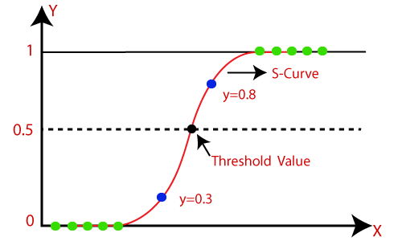
Logistic Regression
https://www.javatpoint.com/logistic-regression-in-machine-learning

Slide 11
Multinomial Regression
Also called Multinomial Logistic Regression
Main differences:
Activation Function: Softmax
Loss Function: Categorical Cross Entropy
Labels are One-Hot Encoded
https://programmathically.com/the-softmax-function-and-multiple-logistic-regression/

Slide 12
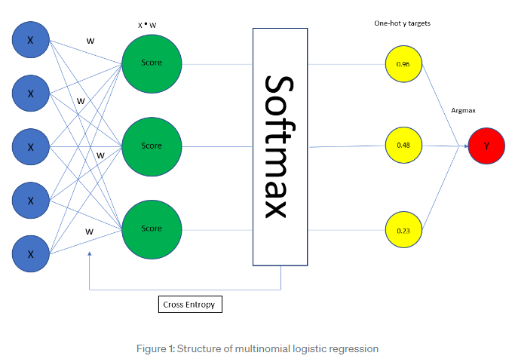
Multinomial Regression
https://medium.com/ds3ucsd/multinomial-logistic-regression-in-a-nutshell-53c94b30448f

Slide 13




Multinomial Regression
Table:
α = learning rate
z = inputs
k = number of classes
y = True labels
β = parameters
Activation function:
Loss function: Derivation of Loss:
https://programmathically.com/the-softmax-function-and-multiple-logistic-regression/

Slide 14



Multinomial Regression
Where z is a vector of inputs with length
equivalent to the number of classes k.
Next we’ll calculate the probability of
the second entry, 3.
Applying the softmax function we can
calculate the output vector for each entry.
https://programmathically.com/the-softmax-function-and-multiple-logistic-regression/

Slide 15
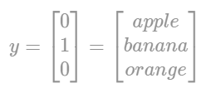
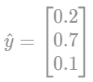

Multinomial Regression
We will classify fruits into one of 3 categories. In this instance, the actual fruit is a banana.
We get the following predicted y values for each of the fruits.
Now we can put it through the loss function.
A convenient feature of this is that the other two
classes go to 0, and the true feature stands out
to be put through gradient descent.

Slide 16
One-vs-Rest/All (OvR or OvA)
Another type of Logistic Regression
Can be used in a similar fashion to Multinomial Regression - for multiple classes
A binary classification is created for each of the classes
The class with the highest score is the predicted class

Slide 17
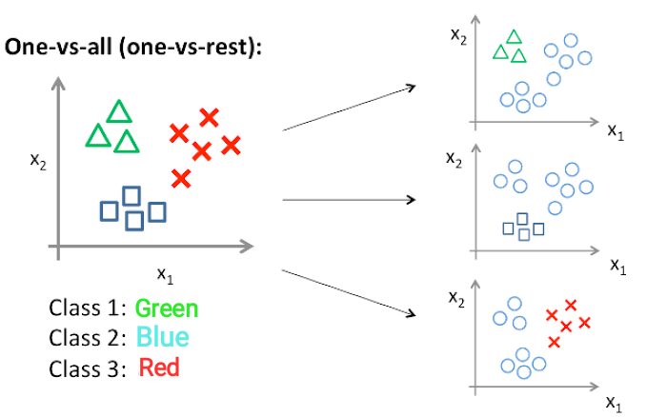
OvR

Slide 18
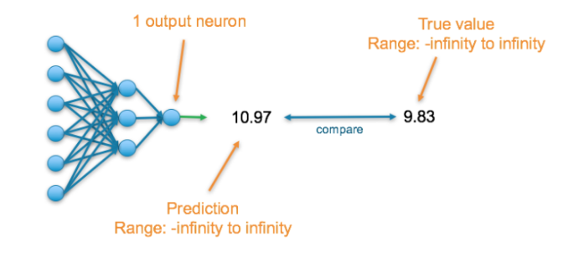
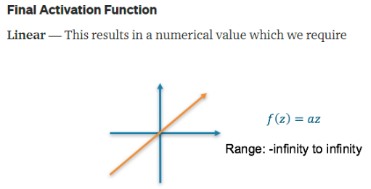
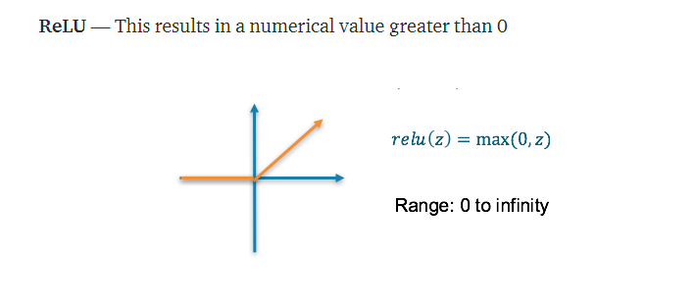
Regular NN

Slide 19
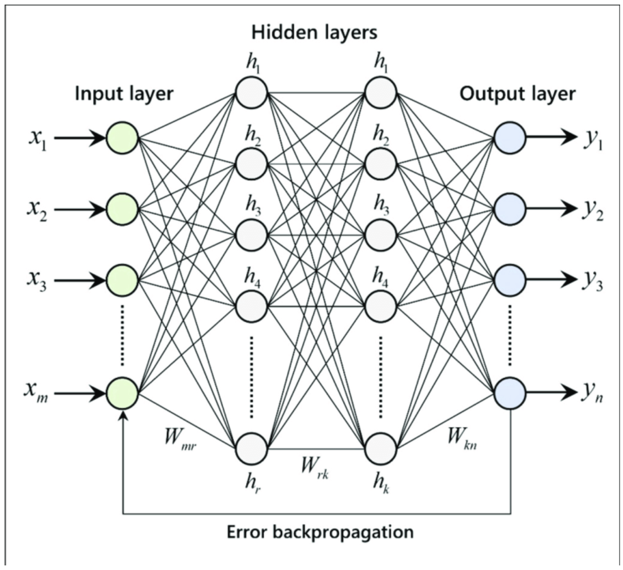
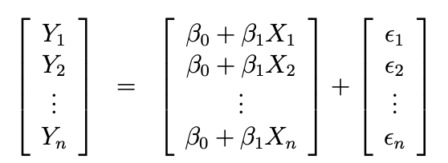
NN vs Regular Regression
Linear Regression: y = mx+b NN Regression: y = wx+b

Slide 20
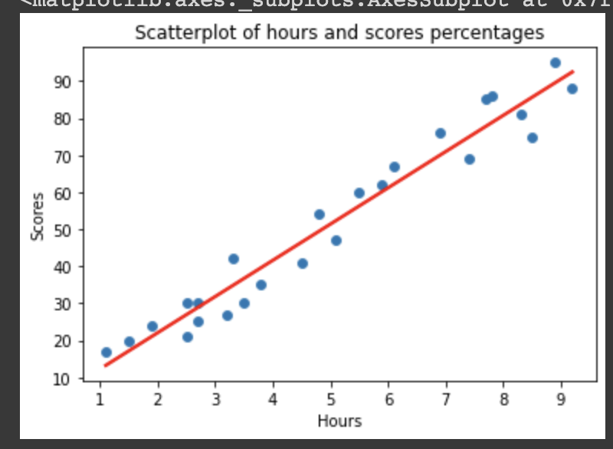
Neural Network Regression
Supervised Algorithm
Not regular regression since it has non-linear hidden layers
Allows non-linear problems
PCA to determine number of layers in network (Rachmatullah et. al, 2021)
Pruning, Construction, Heuristics for number of layers (Stathakis, 2009)
More calculations, takes longer (Back propagation and Feed Forward)

Slide 21
Cons of NN Regression
Overfitting (Desai & Bharati, 1998)
Too many parameters might train model to overfit
Reduce complexity of network through feature selection/hyperparameters
Having complex solution to a simple problem
Hidden layers have non-convex loss functions so it can be stuck at a local minimum with different sets of hyperparameters and initializations. Can lead to less than ideal solutions
Sensitive to feature scaling

Slide 22
Loss Functions
3 Main Types: MSE, Binary Cross Entropy, Categorical Cross Entropy
Models predict probability distribution and dataset has own probability distribution
Cross Entropy: difference between two probability distributions for a given variable (same as MSE but with probabilities)
Want to minimize this difference

Slide 23
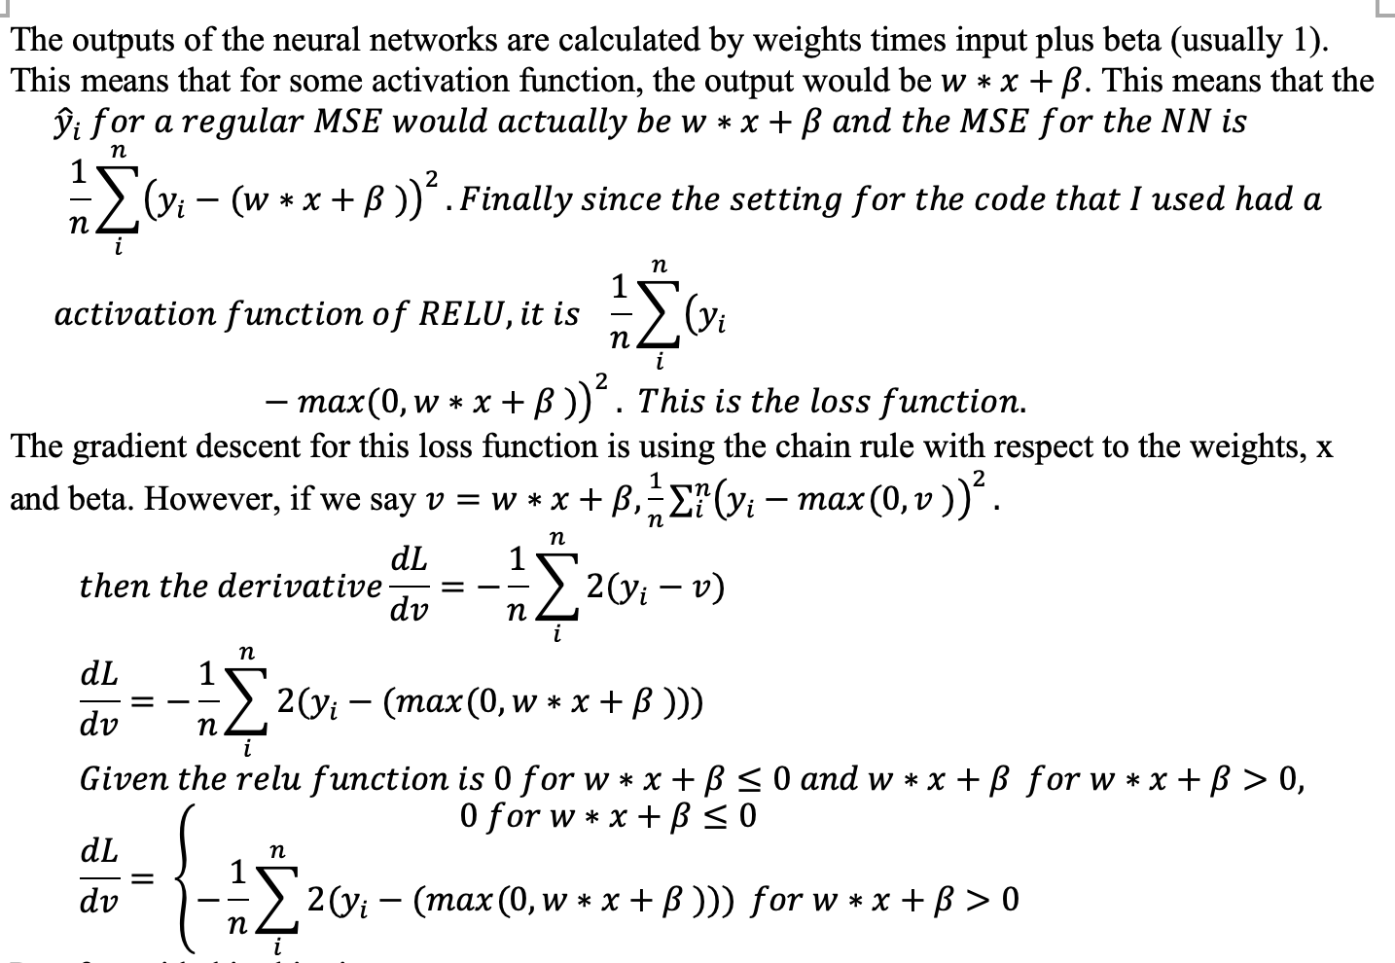
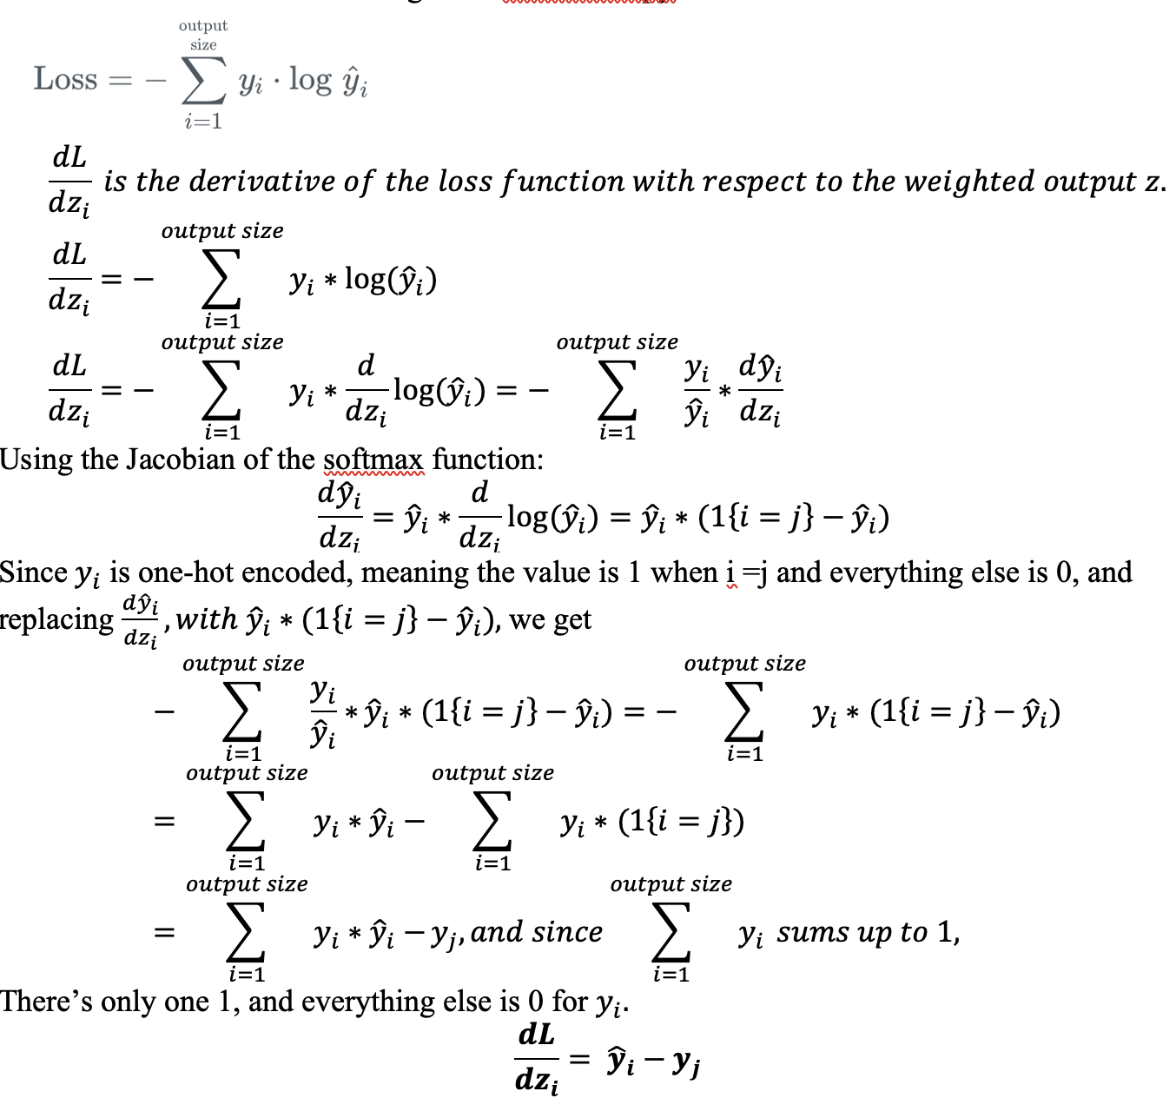
Loss Functions Proof

Slide 24
When to Use NN Regression?
When input data is continuous (can be categorical but must encode it first)
When data mapping is not linear
When regular regression is taking too long for complex data
Rule of Thumb:
Simple data: Regression
Complex data: NN

Slide 25
Cheat Sheet
If output data is continuous:
Activation: Linear, Loss: MSE
If output data is binary: Logistic,
Activation: Sigmoid, Loss: Binary CrossEntropy
If output data is categorical: Multinomial
Activation: Softmax, Loss: Categorical CrossEntropy

Slide 26


Slide 27
References
https://towardsdatascience.com/introduction-to-bayesian-linear-regression-e66e60791ea7
https://www.upgrad.com/blog/types-of-regression-models-in-machine-learning/
https://www.ncbi.nlm.nih.gov/pmc/articles/PMC8459779
https://pubmed.ncbi.nlm.nih.gov/34616896/
https://link.springer.com/article/10.1023/A:1018993831870
https://www.tandfonline.com/doi/full/10.1080/01431160802549278?casa_token=pH_-Le4XT_kAAAAA%3AUny4FcVOG2iHsDrYm-7k27wTYMm0h9uhArSleHL1aUCT4ic9FjS2fBIfpxMEN7BgG6gJYLcD3OLEPg

Slide 28
Questions

